Slide 1







IBM Data Analyst Capstone Project
Manikyala Rao Cherukuri
Jan 2023

Slide 2



OUTLINE
Executive Summary
Introduction
Methodology
Results
Visualization – Charts
Dashboard
Discussion
Findings & Implications
Conclusion
Appendix

Slide 3

EXECUTIVE SUMMARY
The following slides will summarize the data collected as part of 2019 stack overflow developers survey.
This Data Analysis will have the insights regarding the following:
Current Technology Usage (i.e., popular Languages, Databases, Platforms & Web Frames)
Future Technology Usage (I.e., Desired languages, Databases, Platforms, Web Frames)
Demographics (I.e., Gender, Age & Education levels between the Developers along with developers count per country)
These findings will help to understand what are the popular & desired technologies which are mostly liked by the software developers including country wise.

Slide 4

INTRODUCTION
Since 2011, the online programming knowledge sharing platform, Stack Overflow , has been conducting the Overflow Annual Developer Survey.
Stack The primary objective of the annual surveys is to gather data regarding technology usage and trends among developers.
In this analysis, a subset of the 2019 dataset was examined (present dataset: N = 11, 552 ; original dataset N ≈ 90,000).
Audience: Developers (current and aspiring), HR professionals, educators, policy makers

Slide 5

METHODOLOGY
Data Source : 2019 Stack Overflow Developer Survey
Here is the original data source [link]
Data Wrangling: Here, we used the portion of (dataset provided by IBM) and that is cleaned using Python panda's library.
Cleaning steps involved: Duplicates removal, replacing the missing values, normalizing the column values.
Here is the dataset [link]
Exploratory Data Analysis: It has been used to analyze the data [link] and plot the kernel density estimation curve & histogram for desired columns along with boxplot to identify the outliers.
Data Visualizations: Here we have used Sqllite3 along with Python panda's library to analyze the visualize the data and used IBM Cognos to create a dashboard to observe the patterns in the data.

Slide 6
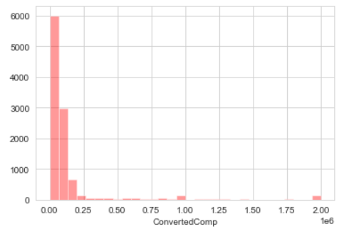
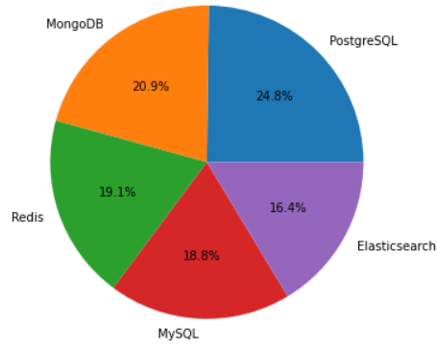
RESULTS
In data wrangling after removing the duplicates and replacing the null values, I have calculated the NormalizedAnnualCompensation for the total number of records 11398.
In Exploratory Data Analysis have made following observations:
I have drawn histogram and kde for the converted annual compensation column and median compensation here is 57745$.
And then calculated the median annual compensation for women i.e., 57708$ after filtered the gender column.
Later drawn the boxplot for converted compensation column to understand and then filter out the outliers. After removing the outliers 10519 would be the final records count.
Here mean & median annual compensations are 59883$ and 52704$ respectively.
In Data Visualization I have drawn a pie chat for top 5 databases, where respondents wish to learn next year.

Slide 7
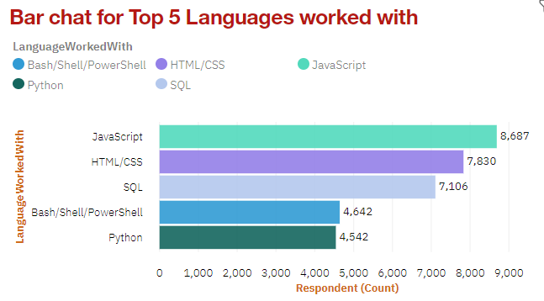
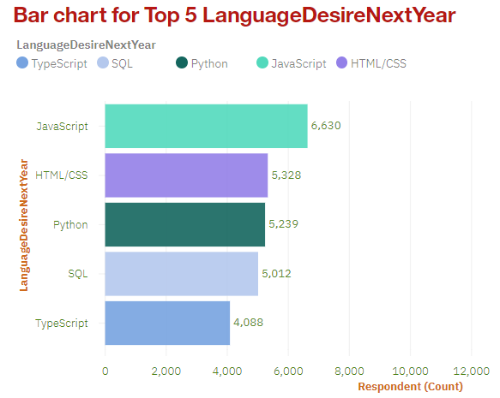
PROGRAMMING LANGUAGE TRENDS

Slide 8
PROGRAMMING LANGUAGE TRENDS - FINDINGS & IMPLICATIONS
Findings
JavaScript were the most popular in 2019 and will likely remain so the following year.
SQL was popular in 2019 and will likely remain so.
Increase interests in Python and TypeScript.
Decreasing interest in PowerShell/ Bash.
Implications
Web development is still in high demand, and JavaScript languages and — HTML/CSS however, remain the dominant TypeScript the future.
SQL remains the preferred language for big data storage and querying and it’s not likely go away anytime soon.
Python rising popularity likely reflects the growth of AI and ML work.

Slide 9
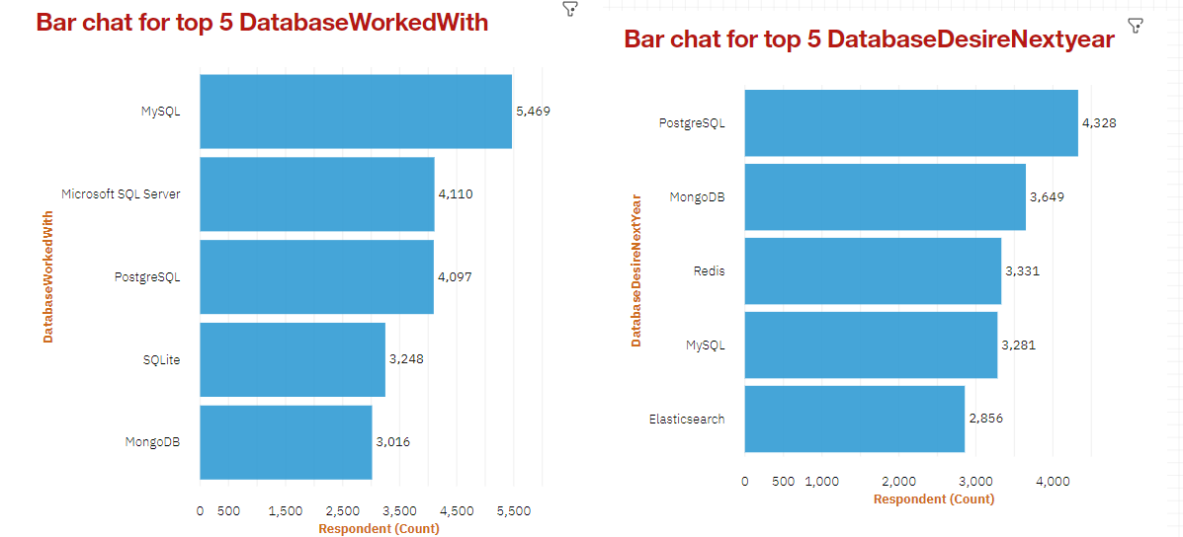
DATABASE TRENDS

Slide 10
DATABASE TRENDS - FINDINGS & IMPLICATIONS
Findings
SQL database programs are the most popular in 2019. MySQL is the lead among them.
PostgreSQL is gaining popularity over other SQL database programs, and it was the overall most desired database for the next year.
MongoDB popular in 2019 and gaining interest.
Increasing interest in Elasticsearch.
Implications
There appears to be increasing developer preference towards open - source database programs.
NoSQL database programs are gaining popularity, which likely reflects a growing need to handle non relational and unstructured data.
Current and aspiring data analysts should develop competence in NoSQL in addition to SQL database programs.

Slide 11

DASHBOARD
The following link contains the full, interactive dashboard summarizing (a) Cognos current technology use future technology trend , and (c) demographics , (b) of the survey respondents:
Click this link to navigate to the dashboard [Ctrl+click]
Static screenshots of the dashboard are shown in the next three slides.

Slide 12
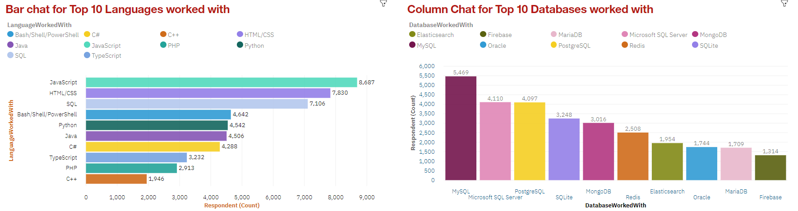
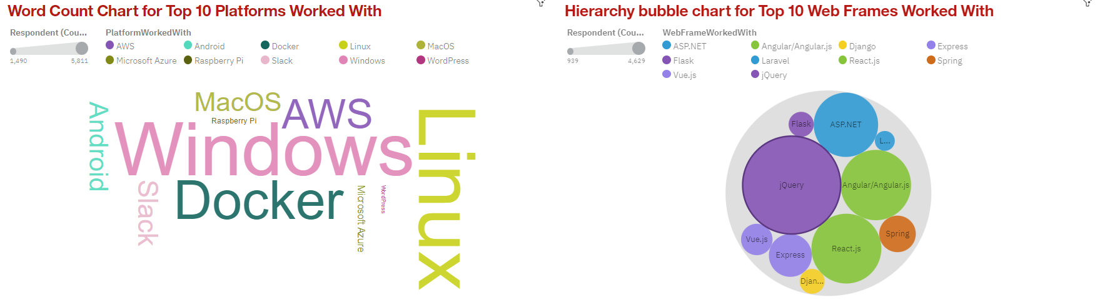
DASHBOARD A: Current Technology Usage:

Slide 13
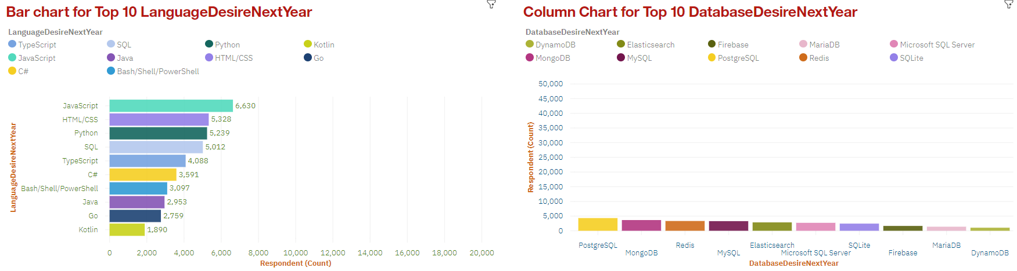
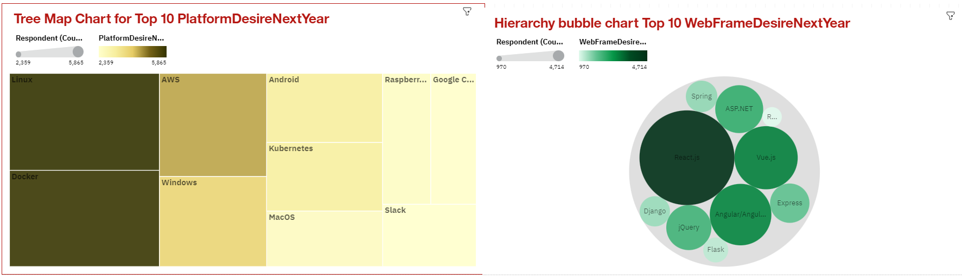
DASHBOARD B: Future Technology Usage:

Slide 14
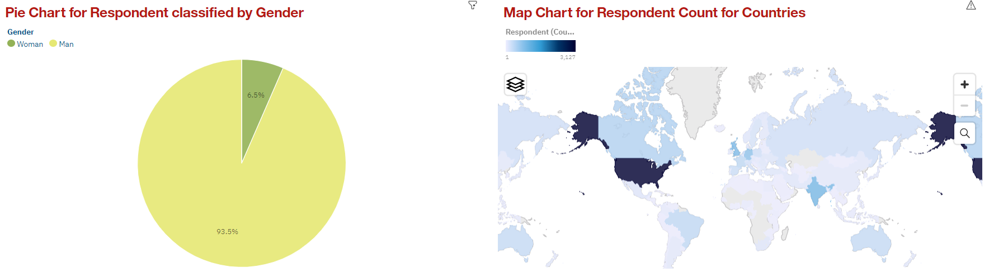
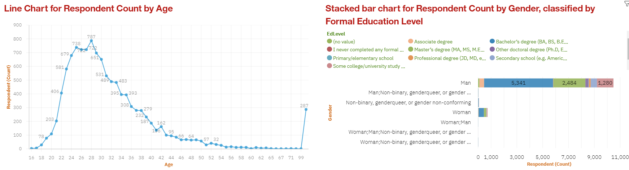
DASHBOARD C: Demographics:

Slide 15
DISCUSSION
Taken together, the findings yield insights into the following questions:
What kinds of developer technologies are in top demand?
Which technologies should prospective developers and data professionals be learning?
Which technologies should educators place more emphasis on teaching in upcoming years?
What does the distribution of annual compensation for developers look like?
What is the developer demographic like? Is there a gender representation gap?

Slide 16
OVERALL FINDINGS & IMPLICATIONS
Findings:
High usage and interest in Java Script & HTML/CSS is remain high usage.
There’s also increasing interest in Python.
High usage and interest in SQL. MySQL had the highest usage in 2019, but PostgreSQL is gaining interest and was the overall most desired database program for the next year.
NoSQL database programs gaining interest, of which MongoDB was the most used in 2019 and desired for the next year.
Technology divide between countries.
Implications:
Web development is still in high demand. Current and prospective developers may consider picking up Typescript in addition to JavaScript and HTML/CSS.
With the growing need to handle big data and perform AI and ML work, data professionals should continue to enhance SQL competence but also enhance competence with NoSQL database programs and Python.
Businesses need to adapt to changing technology preferences, especially in terms of talent acquisition and development.
Policy makers, educators, and organizations should work to minimize the gender representation gap in addition to the technology divide between countries.

Slide 17

CONCLUSION
A subset of data collected as part of the Overflow Developer Survey 2019 Stack was examined.
The findings yielded numerous insights into the technologies most used and desired by developers in addition to the developer demographic.
These insights should be particularly relevant for current and prospective developers aiming to remain competitive, businesses aiming to upskill their talent, educators in the field, and policy makers aiming to address gender and economic issues.

Slide 18
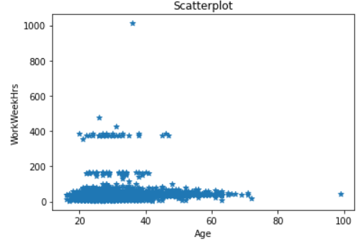
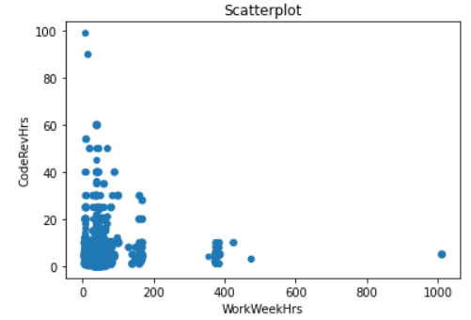
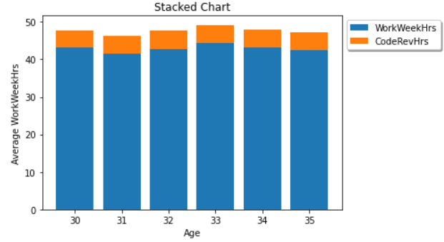
APPENDIX

Slide 19
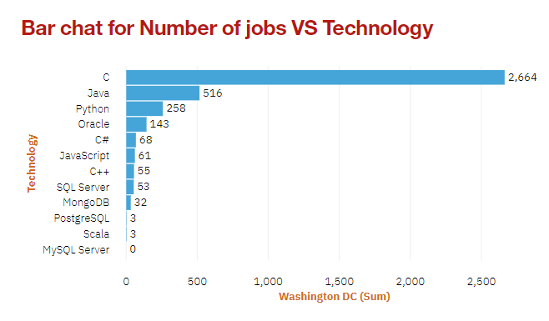
JOB POSTINGS

Slide 20
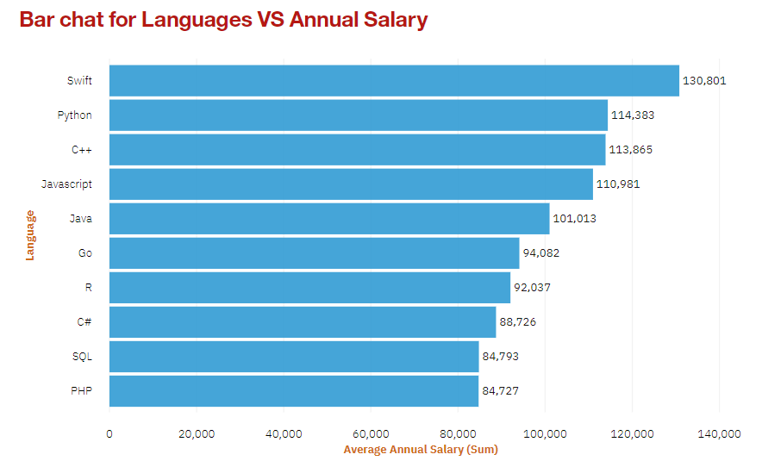
POPULAR LANGUAGES

